Slide 1
Transfer and transform data with Azure Synapse Analytics Pipelines
Notes:
Before delivering this presentation, review the associated modules on Microsoft Learn (https://aka.ms/mslearn-synapse-pipelines) and complete the exercises.

Slide 2



Agenda
Build a data pipeline in Azure Synapse Analytics
Use Spark Notebooks in an Azure Synapse Pipeline

Slide 3
Build a data pipeline in Azure Synapse Analytics

Slide 4








Understand pipelines
Pipelines encapsulate a flow of activities that are orchestrated by an integration runtime
Activities can include:
Data movement and data transformation activities that transfer data from sources to sinks
External processing activities
Control flow activities that manage variables and processing logic
Linked services provide access to data stores and processing platforms where activities can be run
The data processed in a pipeline is defined in datasets, accessed through linked services
Data Flow activity
Source
Transformation
Sink
Pipeline
Dataset
Activities
Dataset
Linked services
Integration runtime
Notes:
Use the diagram on the slide to show the conceptual architecture:
Pipelines consist of activities. They’re listed in the Integrate page in Azure Synapse Studio.
The overall pipeline, including control flow, data flow, and orchestration of activities on linked services is managed in an integration runtime.
Activities can encapsulate data flows (copying and transforming data), call external services, or they can implement control flow logic (loops, branches, variable assignment, and so on)
Linked services are connections to compute resources on which activities can run or datasets can be read/written
Datasets encapsulate data that is passed through the pipeline and can serve as inputs and outputs for activities..
Datasets and linked services can be reused by multiple pipelines. They’re listed in the Data and Manage pages in Azure Synapse Studio.
Pipelines in Azure Synapse Analytics are based on the same technology and user experience as Azure Data Factory. For details of differences between thee two services, see https://learn.microsoft.com/azure/synapse-analytics/data-integration/concepts-data-factory-differences.

Slide 5
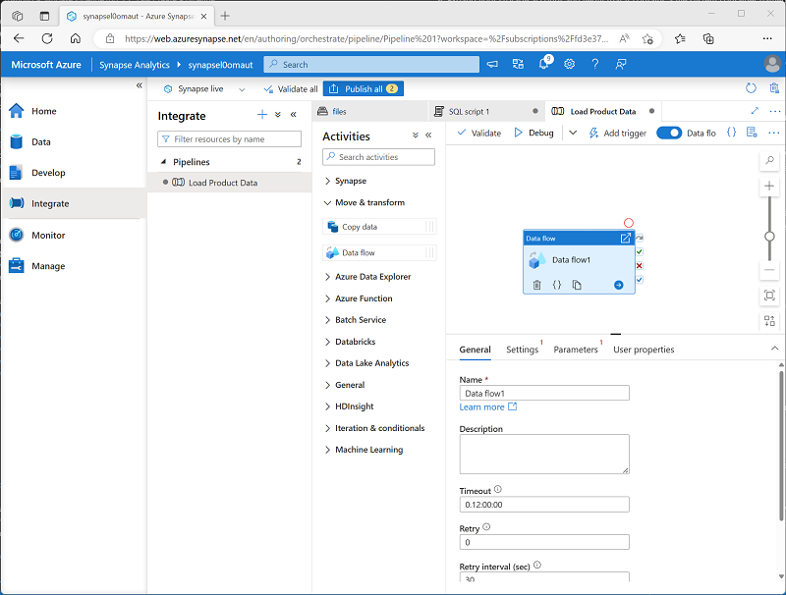
Create a pipeline in Azure Synapse Studio
Create pipelines on the Integrate page
Add and configure activities:
Specify new or existing datasets and linked services as required in settings
They’ll be added to the Data and Manage pages
Connect activities to define processing flow – define paths for:
Succeeded
Failed
Completed
Notes:
You can create pipelines from the home page in Synapse Studio by using the Copy Data wizard; which creates a pipeline with a single Copy Data activity. In some cases, this may be all you need.
However, for more complex data ingestion and ETL processes, you define the pipeline in the Integrate page and use the graphical designer there to define the flow of activities.

Slide 6
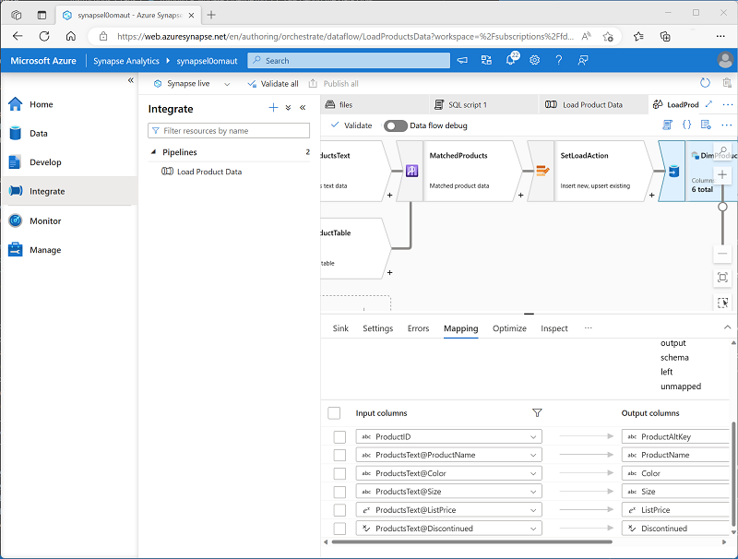
Define data flows
A Data Flow is a commonly used activity type to define data flow and transformation
Consists of:
Sources - Data sets that map to data stores
Transformations – operations on data as it streams through the data flow
Sinks – targets for data to be loaded
Notes:
For activities that encapsulate data flows, a separate graphical designer enables you to define data sources, transformation operations, and sinks. An important part of creating a data flow is to define mappings for the columns as the data flows through the various stages, ensuring column names and data types are defined appropriately.

Slide 7
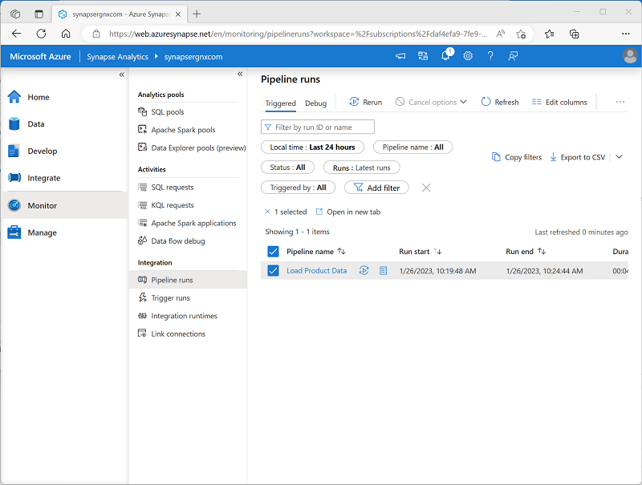
Run a pipeline
Debug pipelines to test during development
Define triggers to run pipelines in production:
Manual – run immediately
Schedule – run at regular intervals
Event – run when an event occurs (such as new data saved in a data store)
Monitor pipeline runs in Azure Synapse Studio
Notes:
While developing a pipeline, you can enable debugging and observe the control and data flow with a subset of the source data to ensure it works as expected.
When you’re ready, you can publish the pipeline and use a trigger to run it. You can then monitor each individual run of the pipeline in the Monitor page in Azure Synapse Studio.

Slide 8

Exercise: Build a data pipeline in Azure Synapse Analytics
Use the hosted lab environment provided, or view the lab instructions at the link below:
https://aka.ms/mslearn-build-synapse-pipeline
Notes:
The exercise will take a minimum of 45 minutes to complete, including 5-10 minutes at the start to set up the environment.
Not all students work at the same pace, so you should allow an hour or more as necessary for your class.

Slide 9

Knowledge check
What does a pipeline use to access external data source and processing resources?
Data Explorer pools
Linked services
External tables
What kind of object should you add to a data flow to define a target to which data is loaded?
Source
Transformation
Sink
What must you create to run a pipeline at scheduled intervals?
A control flow
A trigger
An activity
Notes:
Allow students a few minutes to think about the questions, and then use the animated slide to reveal the correct answers.

Slide 10
Use Spark Notebooks in an Azure Synapse Pipeline

Slide 11

Synapse notebooks and pipelines
Use Synapse notebooks to develop and test data transformation code on Apache Spark
Incorporate notebooks into data ingestion and transformation pipelines
Notebooks run in the specified Spark pool in the Synapse workspace
%pyspark
[#code]
Notes:
There are lots of external processes that you can include in a pipeline, but Spark notebooks are one of the most common. Often, you’ll use Spark code in a notebook to prepare data for exploration or loading into a data warehouse, and then incorporate the notebooks into a pipeline to automate the process with new data as it arrives.

Slide 12
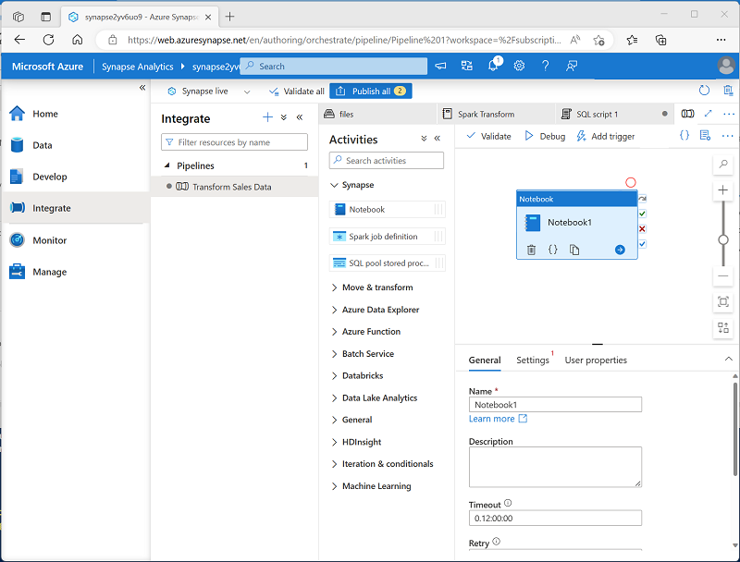
Use a Synapse notebook activity in a pipeline
Add a Notebook activity to a pipeline, specifying:
General properties such as name, timeout, and number of retries
Settings, such as the notebook to be run, the spark pool on which to run it, and parameter values
User properties to define custom configuration values
Notes:
For more details about the Synapse notebook activity, see https://learn.microsoft.com/azure/synapse-analytics/synapse-notebook-activity

Slide 13
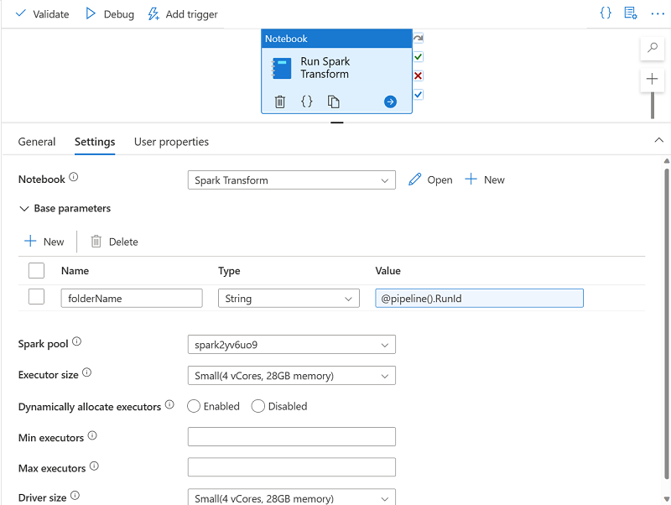
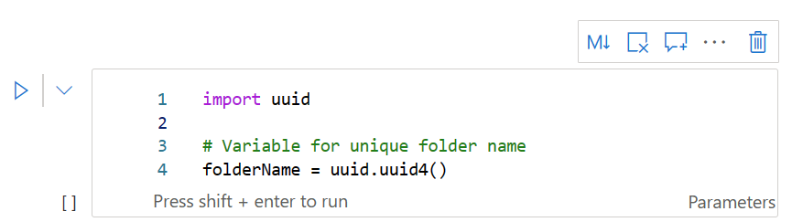
Use parameters in a notebook
Declare variables in a Parameters cell in the notebook, with a default value
Set parameter values in Notebook activity settings
Notes:
Toggling the Parameter setting for a code cell in a notebook makes any variables that are declared in the cell available as parameters. If you do not pass values for these parameters when running the Synapse notebook activity, the values assigned in the variable declaration are used.

Slide 14
Exercise: Use an Apache Spark notebook in a pipeline
Use the hosted lab environment provided, or view the lab instructions at the link below:
https://aka.ms/mslearn-spark-synapse-pipeline
Notes:
The exercise will take a minimum of 30 minutes to complete, including 5-10 minutes at the start to set up the environment.
Not all students work at the same pace, so you should allow 45 minutes or more as necessary for your class.

Slide 15
Knowledge check
What kind of pool is required to run a Synapse notebook in a pipeline?
A Dedicated SQL pool
A Data Explorer pool
An Apache Spark pool
What kind of pipeline activity encapsulates a Synapse notebook?
Notebook activity
HDInsight Spark activity
Script activity
A notebook cell contains variable declarations. How can you use these as parameters?
Add a %%Spark magic at the beginning of the cell
Toggle the Parameters cell setting for the cell
Use the var keyword for each variable declaration
Notes:
Allow students a few minutes to think about the questions, and then use the animated slide to reveal the correct answers.

Slide 16
Further reading
Transfer and transform data with Azure Synapse Analytics Pipelines
https://aka.ms/mslearn-synapse-pipelines
Notes:
Encourage students to review the online material on Microsoft Learn on which this presentation is based.

